Slide 1
Programming Applications
Spring 2021-2022
Assist. Prof. Dr. Pelin GÖRGEL (pelin.gorgel@iuc.edu.tr)
02.03.2022

Slide 2
Checkboxes
<input type="checkbox"> defines a checkbox. Checkboxes let a user select ZERO or MORE options of a limited number of choices.
<form>
<input type="checkbox" name="vehicle" value="Bike">I have a bike<br>
<input type="checkbox" name="vehicle" value="Car">I have a car
</form>

Slide 3
Submit Button
<input type="submit"> defines a submit button.
A submit button is used to send form data to a server.
The data is sent to the page specified in the form's action attribute.

Slide 4

Submit Button (Continued)
<form name="input" action="html_form_action.php">
Username: <input type="text" name="user">
<input type="submit" value="Submit">
</form>

Slide 5
XHTML
XHTML stands for EXtensible HyperText Markup Language
XHTML is almost identical to HTML 4.01
XHTML is a stricter and cleaner version of HTML 4.01
XHTML is supported by all major browsers.

Slide 6
Why XHTML?
Many web pages contain missing HTML code.
<html>
<head>
<title>This is bad HTML</title>
<body>
<h1>Bad HTML
<p>This is a paragraph
</body>

Slide 7
Why XHTML?
Today's market consists of different browser technologies. Some browsers run on computers and some browsers run on mobile phones or other small devices.
Smaller devices often lack the resources or power to interpret a "bad" markup language.
Therefore - by combining the strengths of HTML and XML, XHTML was developed. XHTML is HTML redesigned as XML.

Slide 8
The Most Important Differences from HTML
XHTML DOCTYPE is mandatory
The XML namespace attribute in <html> is mandatory
<html>, <head>, <title>, and <body> is mandatory
XHTML elements must always be closed
XHTML elements must be in lowercase

Slide 9
The Most Important Differences from HTML
XHTML elements must be properly nested.
Some elements can be improperly nested within each other:
<b><i>This text is bold and italic</b></i> wrong
<b><i>This text is bold and italic</i></b> right

Slide 10
The Most Important Differences from HTML
Attribute names must be in lower case
Attribute values must be double quoted
<table width=100%>wrong
<table width="100%"> right

Slide 11
A Sample Web Page-1
<!DOCTYPE html>
<html>
<body bgcolor= "pink">
<p><b>This text is bold</b></p>
<p><strong>This text is strong</strong></p>
<p><i>This text is italic</i></p>
<p><small>This text is small</small></p>
<p>This is<sub> subscript</sub> and <sup>superscript</sup></p>
</body>
</html>

Slide 12
A Sample Web Page-2
<!DOCTYPE html>
<html>
<body>
<p>Create a link of an image:
<a href="http://www.istanbul.edu.tr">
<img border=“1” src="smiley.gif" alt="HTML tutorial" width="32" height="32"></a></p>
<p>No border around the image, but still a link:
<a href=" http://google.com ">
<img border="0" src="smiley.gif" alt="HTML tutorial" width="32" height="32"></a></p>
</body></html>

Slide 13
A Sample Web Page-3 (Colspan-Rowspan)
<!DOCTYPE html>
<html>
<body>
<h4>Cell that spans two columns:</h4>
<table border="1">
<tr>
<th>Name</th>
<th colspan="2">Telephone</th>
</tr>
<tr>
<td>Bill Smith</td>
<td>555 77 854</td>
<td>555 77 855</td>
</tr></table>

Slide 14
A Sample Web Page-3 (Continued)
<h4>Cell that spans two rows:</h4>
<table border="1">
<tr>
<th>First Name:</th>
<td>Bill Smith</td>
</tr>
<tr><th rowspan="2">Telephone:</th>
<td>555 77 854</td>
</tr>
<tr>
<td>555 77 855</td>
</tr>
</table></body></html>

Slide 15
A Sample Web Page-4
<!DOCTYPE html>
<html>
<head>
<title>b tag</title>
<style>
body {background-color: powderblue;}
h1 {color: blue;}
p {color: red;}
</style></head>
<body>
<h1>Programming Applications Lesson</h1>
<p>
Without <strong>internet</strong> we can not reach the slides
</p>
<p>
<b>Introduction: </b> A computer science portal </p>
</body>
</html>

Slide 16
HTML Layouts - Using <div> Elements
You can use divided parts for a well-arranged page appearance.
Start your division with the division alignment tag, including the justification you wish the text or images to take on (i.e. right, left, center):
Example: <div align="center">
End the division justification alignment with the tag:
</div>

Slide 17
HTML Layouts - Using <div> Elements
The div element is a block level element used for grouping HTML elements.
The following example uses five div elements to create a multiple column layout, creating the same result as in the previous example:

Slide 18
A Simple Page With <div> Tag
<!DOCTYPE html>
<html>
<body>
<div id="container" style="width:500px">
<div id="header" style="background-color:#FFA500;">
<h1 style="margin-bottom:0;">Main Title of Web Page</h1></div>
<div id="menu" style="background-color:#FFD700;height:200px;width:100px;float:
left;">
<b>Menu</b><br>
HTML<br>
CSS<br>
JavaScript</div>

Slide 19
A Simple Page With <div> (continued)
<div id="content" style="background-color:#EEEEEE;height:200px;width:400px;float:
left;">
Content goes here</div>
<div id="footer" style="background-color:#FFA500;clear:both;text-align:center;">
Copyright © W3Schools.com</div>
</div>
</body>
</html>

Slide 20
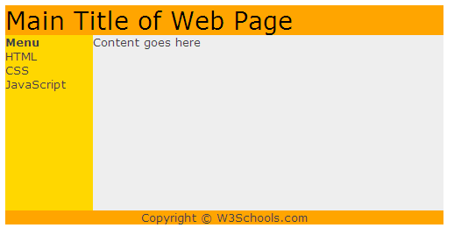
The HTML code above will produce that page:

Slide 21
HTML Styles - CSS
CSS (Cascading Style Sheets) is used to style HTML elements:
Inline - using the style attribute in HTML elements. It has the highest priority
Internal - using the <style> element in the <head> section
External - using an external CSS file

Slide 22
Inline CSS
<!DOCTYPE html>
<html>
<body style="background-color:yellow;">
<h1 style="font-family:verdana;">heading 1</h1>
<p style="font-family:arial;color:red;font-size:20px;">1st paragraph.</p>
<h2 style="background-color:red; ">heading 2</h2>
<p style="background-color:green;"> 2nd paragraph.</p>
<h3 style="text-align:center; "> heading 3</h3>
<p>3rd paragraph.</p>
<p style="color:blue;margin-left:20px; ">4th paragraph.</p>
</body>
</html>

Slide 23
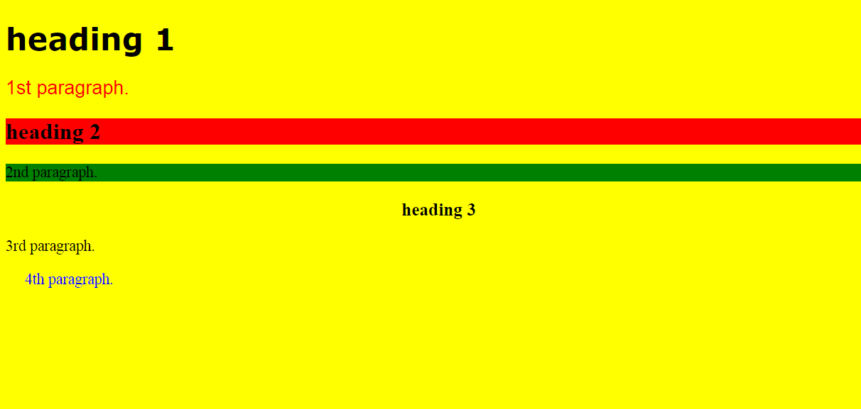
Inline CSS

Slide 24
Internal CSS
An internal style sheet can be used if one single document has a unique style (when using a common style) Internal styles are defined in the <head> section of an HTML page, by using the <style> tag, like this:
<head>
<style type="text/css">
body {background-color:yellow;}
p {color:blue;}
</style>
</head>

Slide 25
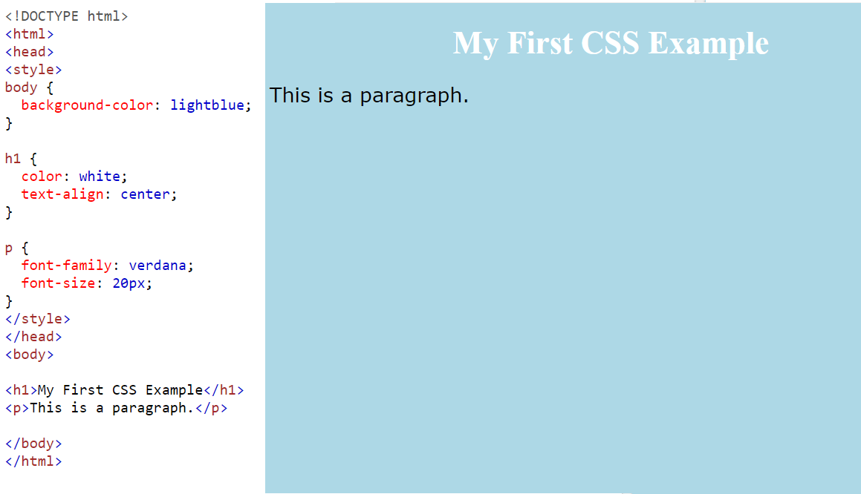
Internal CSS

Slide 26
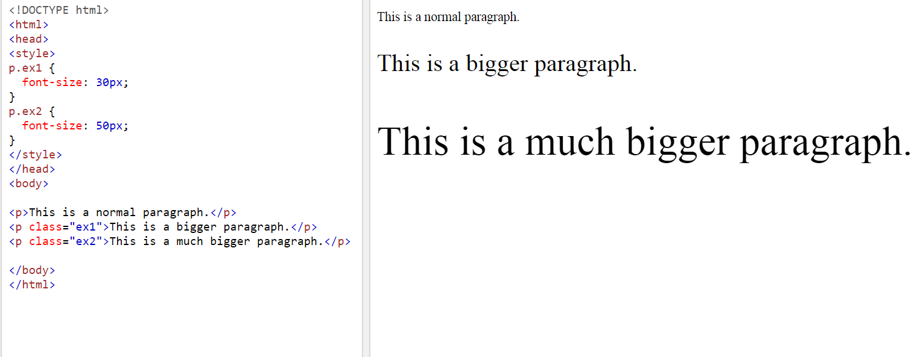
Internal CSS

Slide 27
External CSS
An external style sheet is ideal when the style is applied to many pages.
With an external style sheet, you can change the look of an entire Web site by changing one file.
Each page must link to the style sheet using the <link> tag. The <link> tag goes inside the <head> section:
This has the attributes rel, type, and href. The rel attribute tells what you are linking (in this case a stylesheet), the type defines file type. Type for the browser, and the href is the path to the .css file.
<head>
<link rel="stylesheet" type="text/css" href="mystyle.css">
</head>

Slide 28
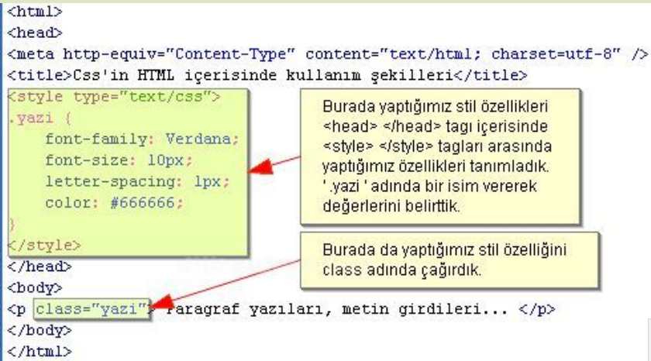
CSS Examples -1
(Internal CSS)

Slide 29
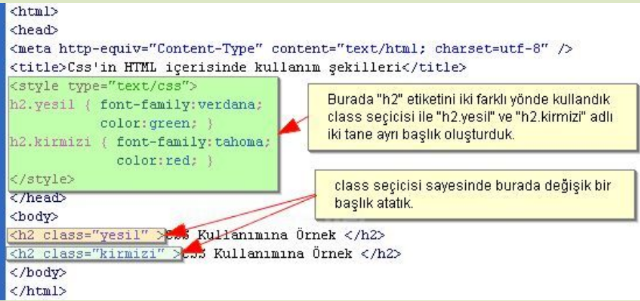
CSS Examples -2
(Internal CSS)

Slide 30
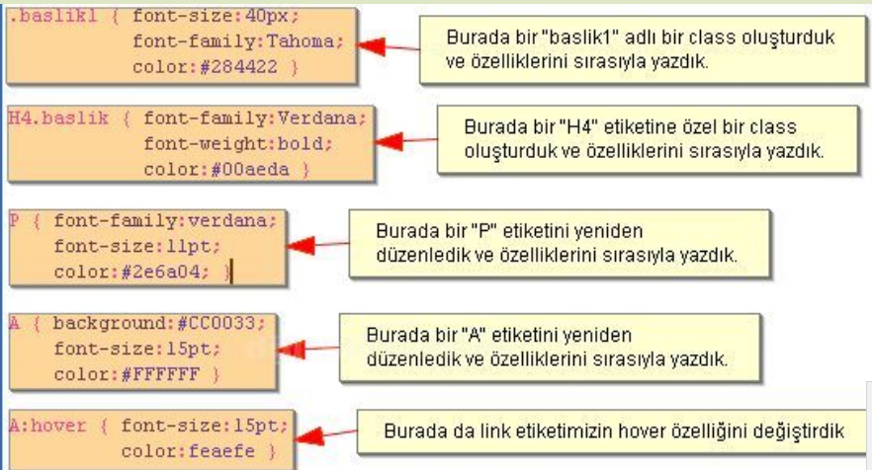
CSS Examples -3
(External CSS
How to Define stil.css)

Slide 31
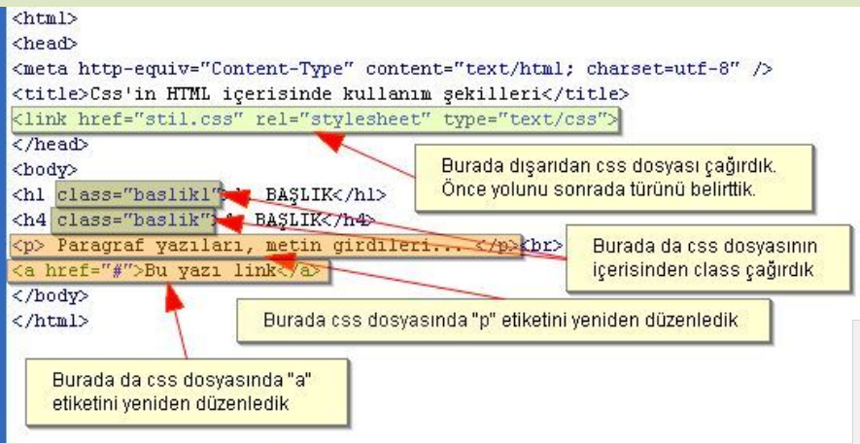
CSS Examples -3
(How to Use stil.css)

